Slide 1
Lecture 28 November 13th , 2019
Tomorrow in lab—
Finish Bacterial Transformation
Discuss gene expression regulation
Analyze F1 flies and discuss 3-point mapping

Slide 2
Where were we?…
Linked genes---Recombination mapping. Tetrads and crossing over. 50% max recombination frequency—which is meaningless. Mendel’s “luck” in avoiding the complication of explaining linkage.
*Tomorrow. Continue with our crosses and the concept of 3-point mapping using recombination frequencies.

Slide 3
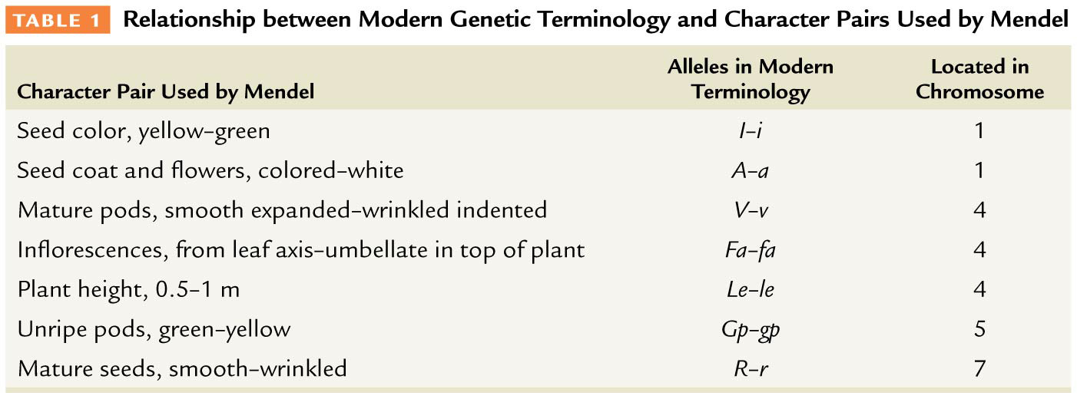
Table 5–1

Slide 4
Why did Mendel only describe independently assorting unit factors?!
For the dihybrid crosses he studied only, those involving linked genes included genes that are so distantly linked on the chromosome that they appear unlinked (~50% recombination)

Slide 5
Moving into molecular genetics Chapter 10
Includes study of the genetic material
Genetic mechanisms
Replication
Transcription
Translation
Gene expression (transcription, translation, and regulation of these processes)

Slide 6
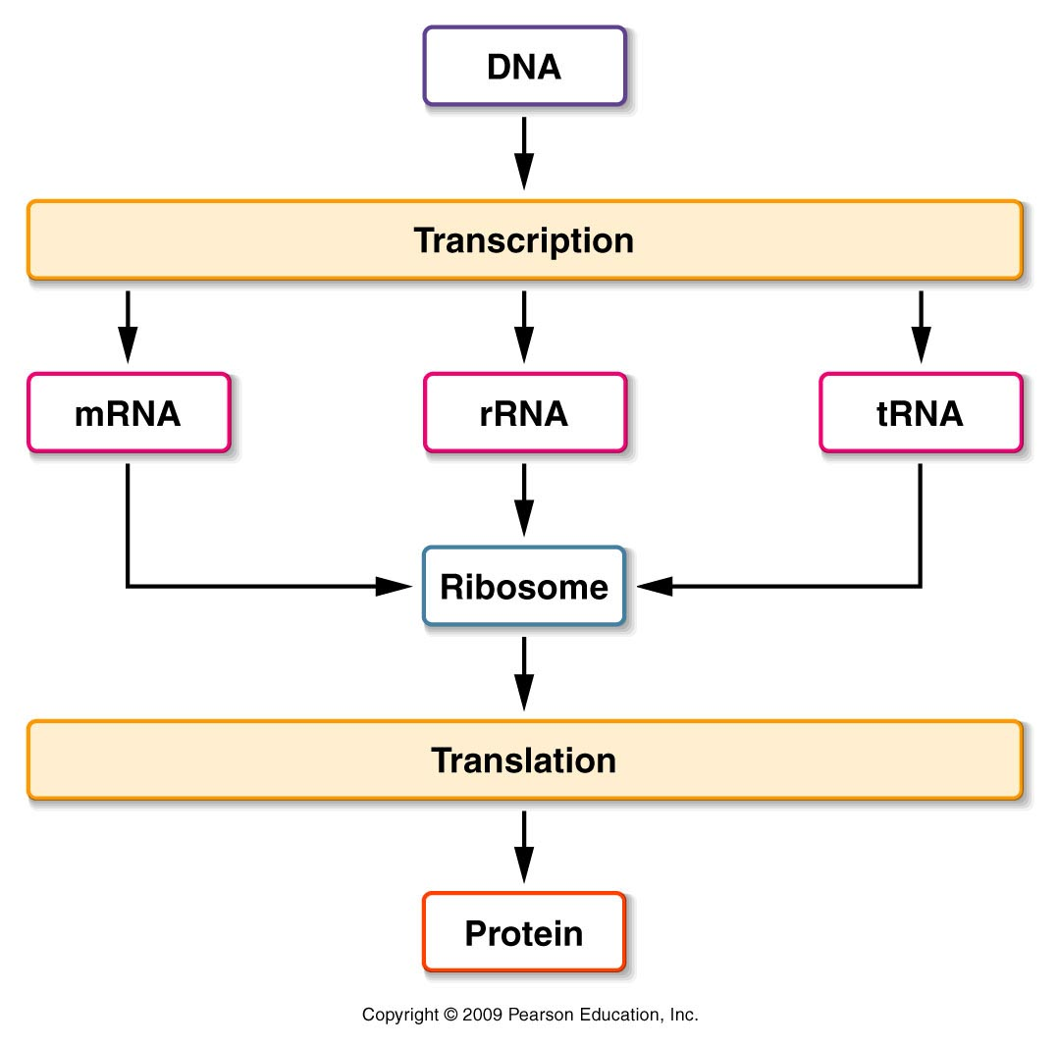
Insert 10.1
microRNA
Has direct activity as RNA

Slide 7
Much of chapter 10 should be a review of basic information about the genetic material. Read and review!

Slide 8
Expected characteristics of a molecule of heredity…
Molecule capable of storing information for observable traits (“recipe for the organism and all its traits and activities)
Transferred to offspring in gametes—where information can be decoded/read. The genetic material would hold the developmental program pf the organism.
Stable (not easily destroyed) molecule capable of accurate replication
Molecule capable of some change—responsible for the observed variation

Slide 9
Protein vs. Nucleic acid…
In the first half of the 20th century, geneticists focused on identifying the genetic material.
Proteins and nucleic acids (DNA and RNA) seemed like good candidates.
Both are abundant in cells and eukaryotic chromosomes are composed of both DNA and proteins.

Slide 10
Protein---a more likely candidate at first….
A component of chromosomes
Most abundant molecule in cells. (If you exclude water, cells are ~ 50% protein)
Complexity—capacity to vary
Proteins made of 20 types of subunits (amino acids)
Nucleic acids made of only 4 types of subunits (nucleotides)

Slide 11
3 pivotal experiments showed DNA, not protein to be the genetic material
Fred Griffith (1928)---started the observations…
Shows evidence of a “transforming principle” capable of moving from one type of bacteria into another. Changed them from avirulent into virulent.
Transforming principle was heat stable and could be obtained from dead bacteria.

Slide 12
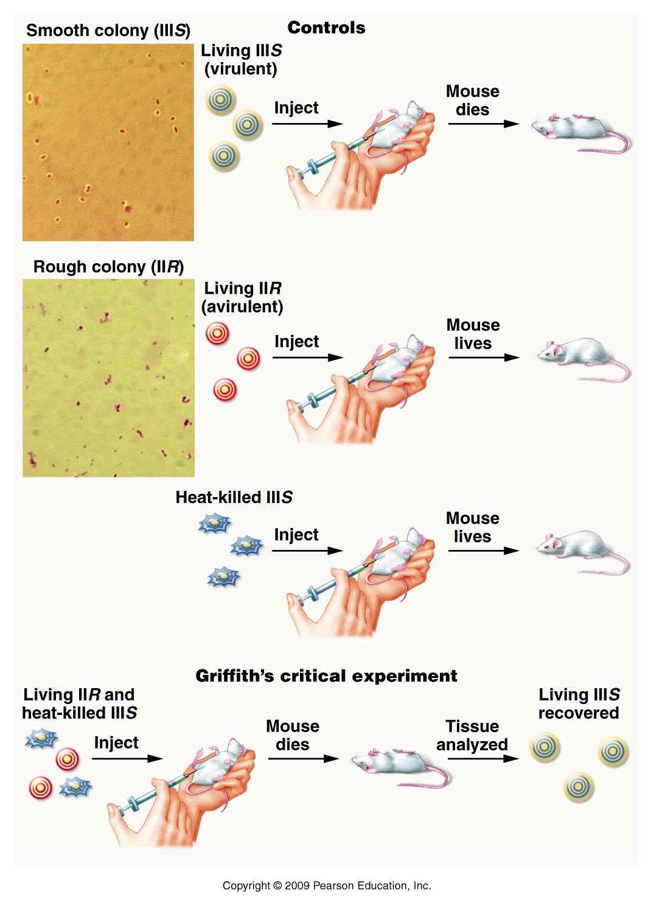
Figure 10.3
Notes:
Figure 10-3 Griffith’s transformation experiment. The photographs show bacterial colonies containing cells with capsules (type IIIS) and without capsules (type IIR).

Slide 13
Linonel Alloway and Henry Dawson repeated Griffith’s experiment and showed the same result when the bacteria were lysed/broken open and extracts of the bacteria were used.
Filtering out insoluble material did not alter the outcome….genetic material seemed to be water soluble.

Slide 14
Avery,MacLoed, McCarty
Also repeated Griffith’s basic experiment. (using bacterial extracts)
Systematically eliminated candidate molecules from the extracts and noted where transformation occurred or did not occur.

Slide 15
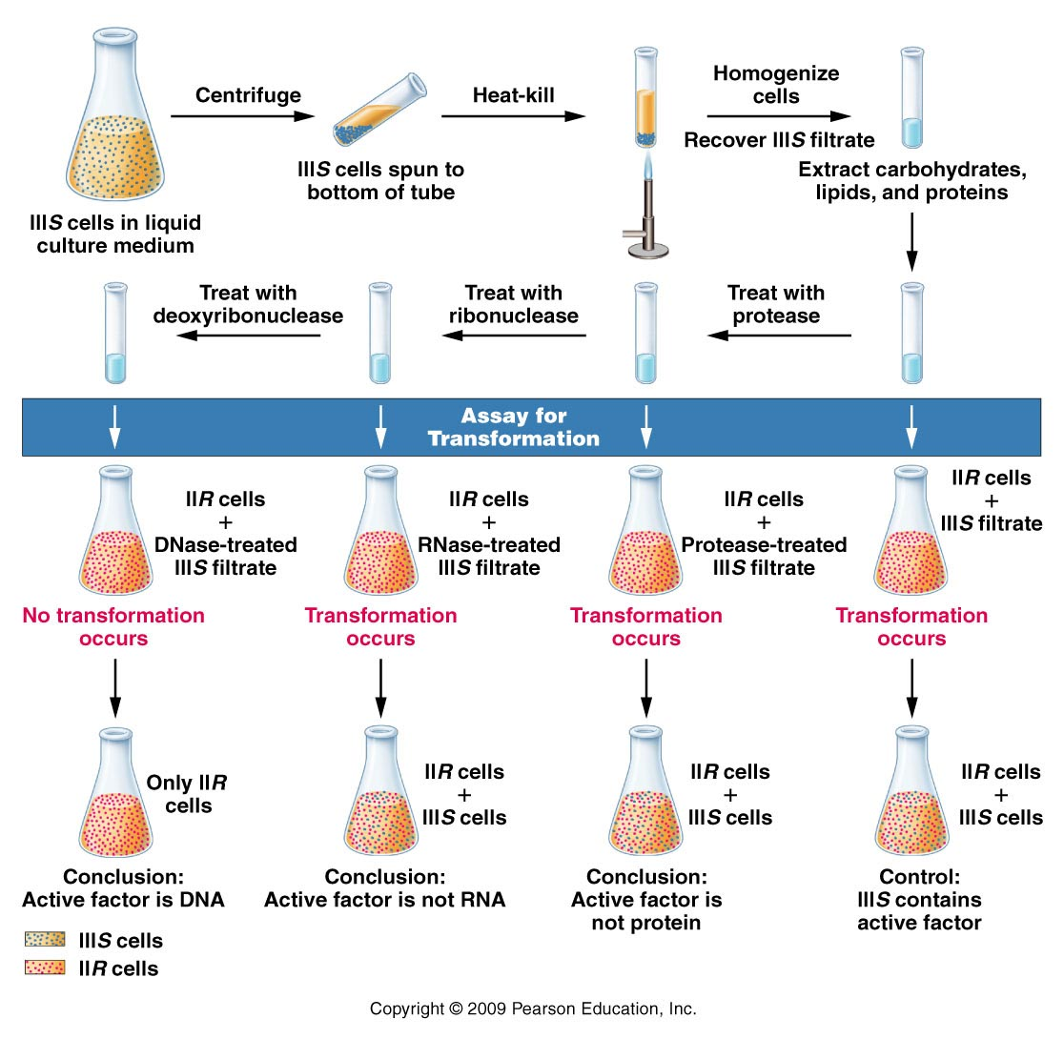
Figure 10.4
Notes:
Figure 10-4 Summary of Avery, MacLeod, and McCarty’s experiment, which demonstrated that DNA is the transforming principle.

Slide 16
Observations
Destroy proteins with proteases
Transformation still occurs
Destroy RNA with RNases
Transformation still occurs
Destroy DNA with DNases
Transformation does NOT occur

Slide 17
Conclusion?....
DNA is the transforming principle, the genetic material---the recipe for the trait(s) that changed in the bacteria.

Slide 18
Another approach… Alfred Hershey and Martha Chase
Used viruses that infect bacteria--called bacteriophages—Why?
Known to be composed of both DNA and protein
Known life cycle
Assay to track transmission of protein vs. DNA from phage to bacteria.

Slide 19
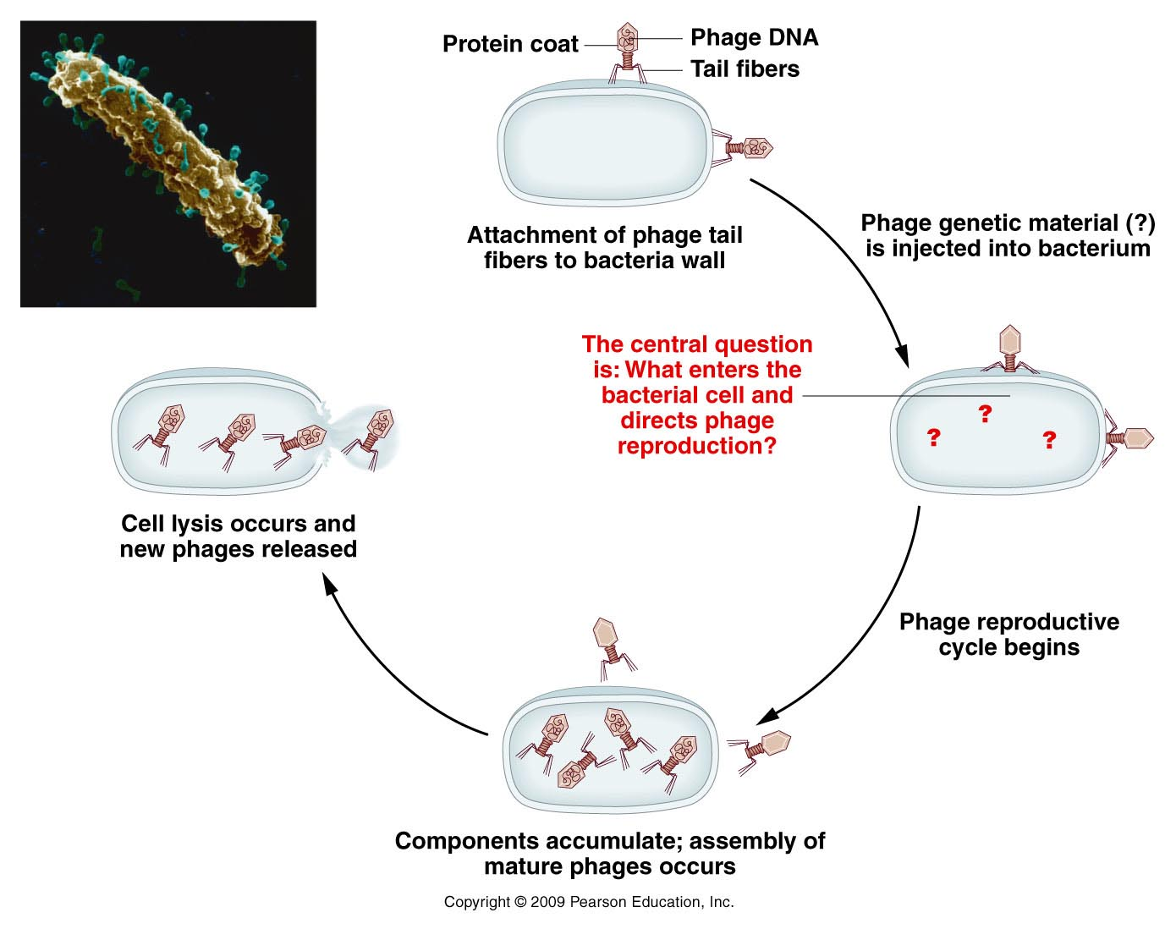
When one organism receives genetic
material carried by a virus, the process is called transduction (similar to transformation)
Figure 10.5
Notes:
Figure 10-5 Reproductive cycle of a T-even bacteriophage, as known in 1952. The electron micrograph shows an E. coli cell during infection by numerous phages.

Slide 20
Tracking protein vs. DNA---Hershy and Chase were clever to think of a chemical difference between proteins and nucleic acids.
DNA contains phosphorus but not sulfur
Protein contains sulfur but not phosphorus.
At the time of these experiments, scientists were starting to use radioactive isotipes of atoms as tracers for specific molecules.
*Labeling protein with (S³⁵) and DNA with (P³²)----different radioisotopes and could allow tracking of the different molecules in the life cycle of the phage.

Slide 21
What is expected of the genetic material?...
It will enter the bacterium, since the phage must use the bacterium as a host to replicate. It would hold the developmental program for the phage.
It will be carried in/by new phage, directing construction of a new phage, but will not necessarily be incorporated into new phage parts.

Slide 22
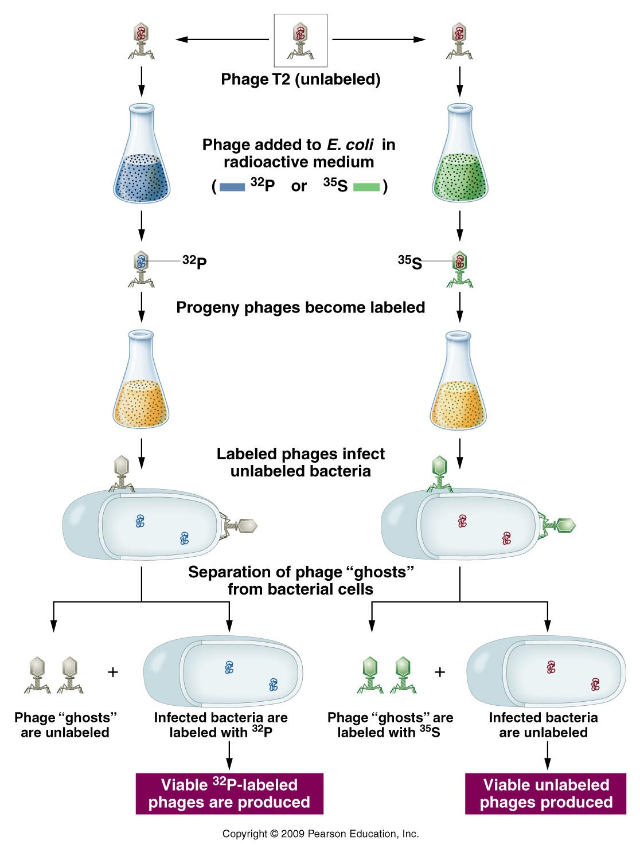
The experiment…
At this point, when the infected bacteria were examined, these bacteria were radioactive.
At this point, when the infected bacteria were examined, these bacteria were not radioactive.
At this point, when newly made phage were examined, they were not radioactive.
At this point, when newly made phage were examined, they were radioactive.
Figure 10.6
Notes:
Figure 10-6 Summary of the Hershey–Chase experiment demonstrating that DNA, and not protein, is responsible for directing the reproduction of phage T2 during the infection of E. coli.

Slide 23
Conclusion…
Even though the infecting phage incorporated either P-32 or S-35 into phage components, the infected bacteria and the new “offspring” phage only contained P-32.
The molecule of heredity was p-32 labeled DNA, not protein. The recipe for new phage was in the DNA.

Slide 24
On to Nucleic acid chemistry…
Nucleic acids----DNA and RNA
Both are polymers (repeating units) of nucleotides.

Slide 25
Nucleotides…
3 components
5-carbon (pentose) sugar
Nitrogenous base
PO₄ group(s)
1 PO₄ group =nucleoside monophosphate
2 PO₄ groups =nucleoside diphosphate
3 PO₄ groups =nucleoside triphosphate
Nucleoside

Slide 26
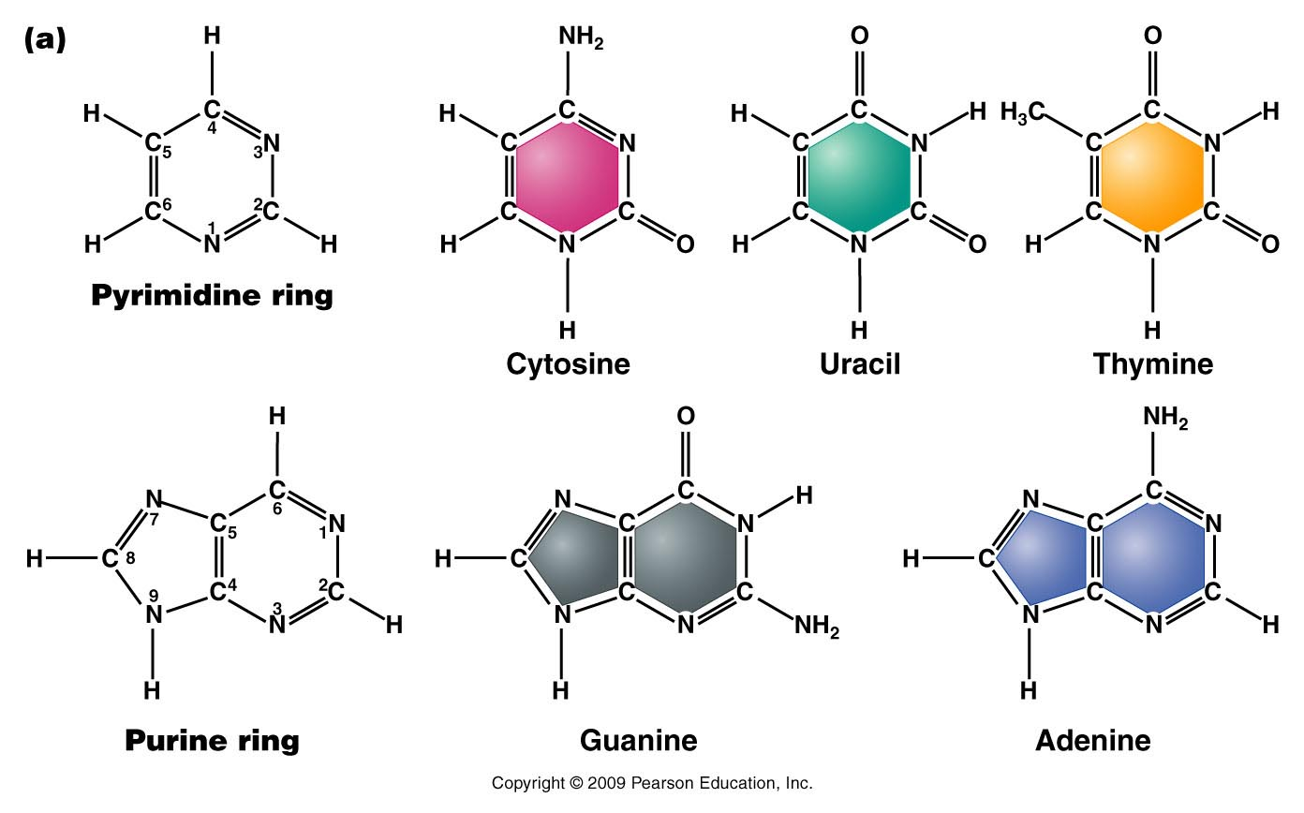
The bases---Do not memorize atomic structure but recognize pyrimidine vs. purine—note all contain nitrogen.
Figure 10.9a
Notes:
Figure 10-9a (a) Chemical structures of the pyrimidines and purines that serve as the nitrogenous bases in RNA and DNA. The nomenclature for numbering carbon and nitrogen atoms making up the two bases is shown within the structures that appear on the left. (b) Chemical ring structures of ribose and 2-deoxyribose, which serve as the pentose sugars in RNA and DNA, respectively.Web Tutorial 10.1DNA Structure

Slide 27
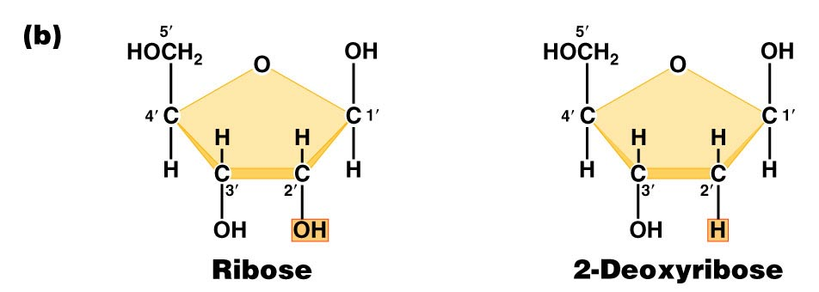
Pentose sugars in RNA and DNA
DRAW THEM!! Note the numbering of atoms (1’, 2’….carbons).
Found in RNA
Found in DNA
Figure 10.9b
Notes:
Figure 10-9b (a) Chemical structures of the pyrimidines and purines that serve as the nitrogenous bases in RNA and DNA. The nomenclature for numbering carbon and nitrogen atoms making up the two bases is shown within the structures that appear on the left. (b) Chemical ring structures of ribose and 2-deoxyribose, which serve as the pentose sugars in RNA and DNA, respectively.Web Tutorial 10.1DNA Structure

Slide 28
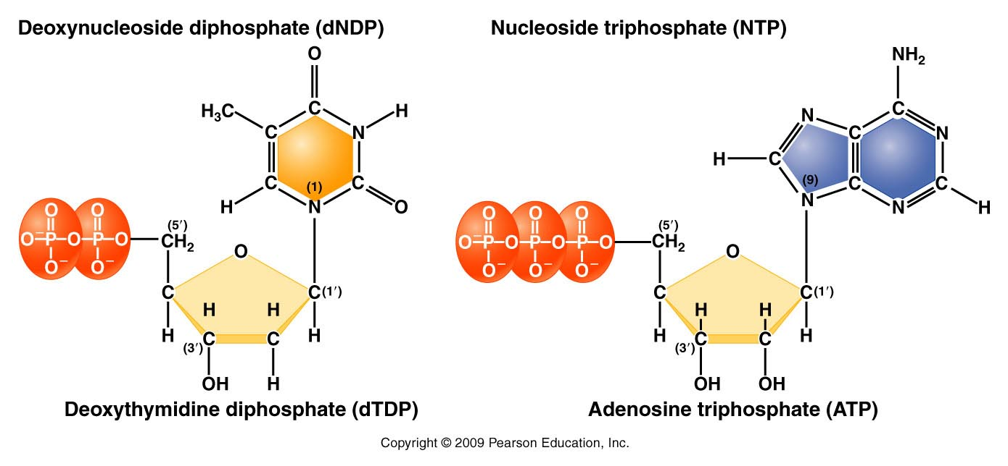
Complete structure of nucleotides
Base forms bond with the 1’ carbon of the sugar
Phosphate forms bond with the 5’carbon of the sugar
d=deoxyribose
no “d”= ribose
Figure 10.11
Notes:
Figure 10-11 Basic structures of nucleoside diphosphates and triphosphates, as illustrated by deoxythymidine diphosphate and deoxyadenosine triphosphate

Slide 29
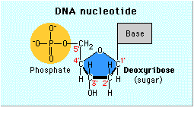
Sketch a nucleotide—show this level of detail
Need not show atomic detail of all bases
Need to show carbon numbering of the sugar
Phosphate groups
Thymine

Slide 30
When talking about any or all RNA or DNA building blocks we us “N” to designate any/all of the bases. For example, dNTP—could be dATP, dCTP, dTTP, or dGTP. If dNPT is plural (dNTPs), we are referring to all 4 DNA nucleotides.
Recognize small differences in structure/chemical make up!
Be sure to be able to distinguish between:
dNTPs and NTPs
dNMPs, dNDPs, dNTPs
Be able to recognize a stretch of RNA from a single strand of DNA….

Slide 31
By the way….Nucleotides serve various functions
Nucleic acid (RNA and DNA) building blocks* (our focus here)
Energy molecules (ATP/GTP)
Signaling molecules (cAMP)

Slide 32
DNA/RNA made of chemically linked nucleotides
Specific type of linkage joins adjacent nucleotides
5’ carbon of one nucleotide forms a linkage to the 3’ carbon of the adjacent nucleotide
Phosphate links 2 nucleotides in a phophodiester bond

Slide 33
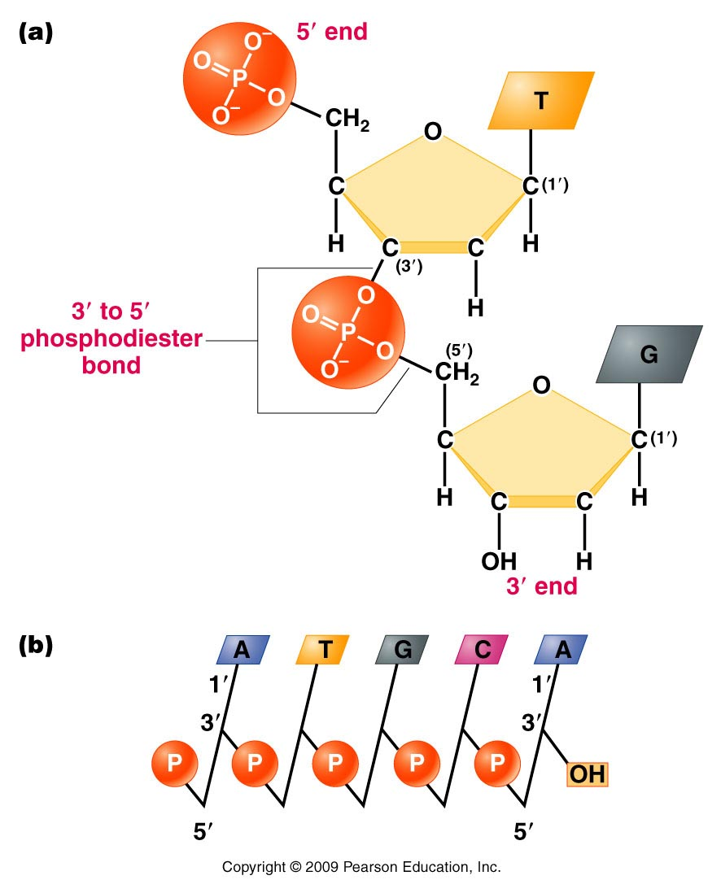
Result is a 5’-3’ linkage and a molecule with 5’ and 3’ ends.
A strand of DNA/RNA
Figure 10.12
Notes:
Figure 10-12 (a) Linkage of two nucleotides by the formation of a C-3’ –C-5’ (3’ –5’) phosphodiester bond, producing a dinucleotide. (b) Shorthand notation for a polynucleotide chain.

Slide 34
RNA exists as a single strand* of nucleotides
DNA is a double strand of nucleotides
Strands are connected via non-covalent bonds between specific bases.
Adenine bonds to Thymine
Cytosine bonds to Guanine
* adenine and uracil (and cytosine and guanine) can form bonds in regions of an RNA single strand or in DNA-RNA hybrids.
Complementary base pairing

Slide 35
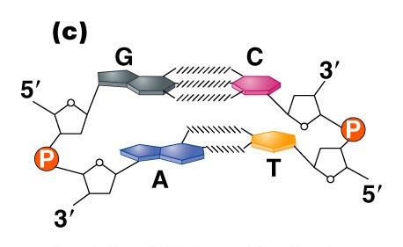
Figure 10.14c
Notes:
Figure 10_14c (a) The DNA double helix as proposed by Watson and Crick. The ribbonlike strands constitute the sugar-phosphate backbones, and the horizontal rungs constitute the nitrogenous base pairs, of which there are 10 per complete turn. The major and minor grooves are apparent. The solid vertical bar represents the central axis. (b) A detailed view depicting the bases, sugars, phosphates, and hydrogen bonds of the helix. (c) A demonstration of the antiparallel nature of the helix and the horizontal stacking of the bases.

Slide 36
Complementary base pairing requires the DNA strands run in opposite directions with respect to 5’ and 3’ ends. (Antiparallel strands)
Complementary base pairing is only possible with a slight twist to each successive base pair. The twisting to accommodate pairing, creates the helical molecule.

Slide 37
(How do we know)? Determining DNA structure…
Double helix is 63 years old!! (knowledge of DNA structure) Published April 25th, 1953.
Watson JD. Crick FHC. A structure for deoxyribose nucleic acid. 1953; Nature 171:737-8.
Watson and Crick got most of the glory…but the discovery of the structure was a very much a group effort.

Slide 38
It began with biochemical studies…
Erwin Chargaff—studied DNA by base composition.
Noted roughly equal concentrations of:
Purines and Pyrimidines
Specifically: [A] = [T] and [C] =[G]

Slide 39
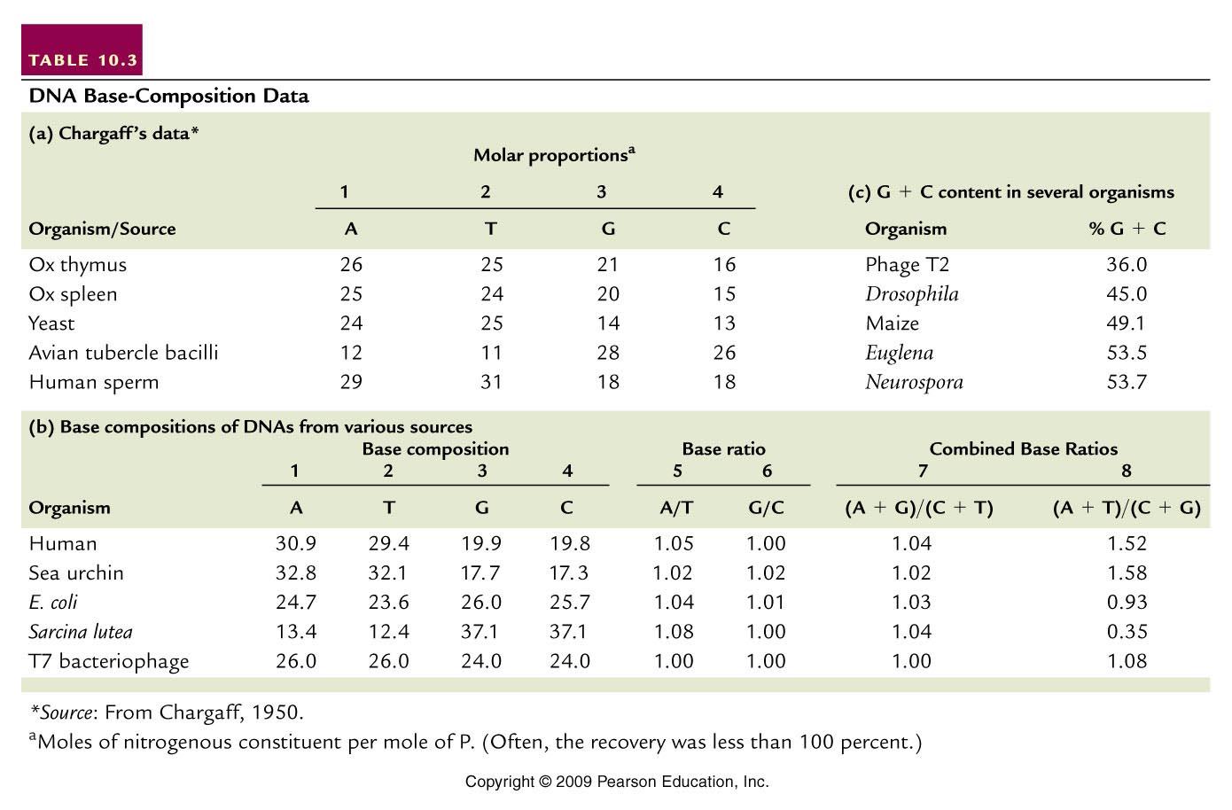
(purines=pyrimidines)
(A+T not = G +C)
Table 10.3
Notes:
Table 10.3 DNA Base Composition Data

Slide 40
Suggested 1:1 interactions of specific bases.
A-T and G-C
Eventually this biochemical ratio supported the specific A-T and G-C base-pairing scheme which facilitates the interaction of 2 DNA strands.

Slide 41
Interestingly---different species have different base compositions---Some are more A/T rich some are more G/C rich.
Humans have more A-T base-pairs than G-C base pairs.
A bacterial species—Sarcinia lutea has more G-C than A-T base pairs.

Slide 42
(purines=pyrimidines)
(A+T not = G +C)
Table 10.3
Notes:
Table 10.3 DNA Base Composition Data

